Slide 1
Employee Attrition Analysis Project
Leveraging Data Science to Understand and Project HR Trends
Name:- Prathamesh Pangare
Saurav Tejam
Mukesh Kale
Date:- 04-01-2024

Slide 2
Agenda
Introduction
Understanding HR Attrition
Project Overview
Data Handling
Exploratory Data Analysis (EDA)
Model Building
Insights and Patterns
Challenges and Solution
Conclusion

Slide 3
Introduction
'Employee Attrition Analysis ' In today's fast-paced corporate world, understanding why employees leave is crucial for any organization's growth and stability. Our project delves into the intricacies of employee attrition, employing advanced data analysis techniques to uncover the underlying reasons behind staff turnover. We aim to provide insights that help in creating a more engaging and fulfilling work environment, ultimately leading to reduced attrition rates and satisfied workforce. This presentation will guide you through our approach, findings, and recommendations, shedding light on how we can better retain talent and foster a positive organizational culture .

Slide 4
Understanding HR Attrition
Definition :- Attrition in HR refers to the natural process of workforce reduction due to employees leaving the company. This can be voluntary, such as through resignations or retirements, or involuntary, like layoffs or terminations.
Types of Attrition :-
Voluntary Attrition: Occurs when employees choose to leave the organization, often for reasons like career advancement, personal reasons, or better opportunities elsewhere.
Involuntary Attrition: Involves employees leaving due to organizational decisions, such as layoffs, restructuring, or termination due to performance issues.

Slide 5
The Role of Data Analysis in Understanding Attrition Leveraging data analytics and machine learning techniques to analyze HR data can provide valuable insights into attrition trends and patterns . This analysis helps in identifying risk factors and predictive indicators, allowing organizations to proactively manage and reduce employee turnover.

Slide 6
Project Overview
Objective: To analyze and predict employee attrition using data-driven approaches, enabling proactive HR strategies. Scope of the Project Data Utilization: Leveraging a comprehensive HR dataset covering various aspects like demographics, job roles, satisfaction levels, income details, and more. Analysis Techniques: Employing Exploratory Data Analysis (EDA) to uncover underlying patterns and using Machine Learning models for prediction.
Methodology
Data Collection: Gathering relevant HR data, ensuring a robust and representative dataset .
Data Preprocessing: Cleaning and transforming data for analysis, including handling missing values, encoding categorical variables, and normalizing data .
Exploratory Data Analysis (EDA): Visualizing and examining data to understand trends, anomalies, and correlations .
Model Building: Developing predictive models using algorithms like Logistic Regression, Decision Trees, Random Forest, and Gradient Boosting.

Slide 7
Insight Generation: Extracting meaningful insights about factors influencing attrition and predicting future trends.
Goals and Expectations Predictive Insights: Identifying key factors that contribute to employee attrition, facilitating targeted intervention strategies.
Actionable Recommendations: Providing data-backed recommendations to HR for policy and strategic adjustments.
Enhancing HR Practices: Using the findings to improve employee retention, job satisfaction, and overall workplace environment.

Slide 8
Data Handling
Data Collection and Acquisition: Briefly describe the sources of your HR data, ensuring it's comprehensive and representative of the workforce.
Data Cleaning: Highlight the steps taken to clean the data. This includes handling missing values, removing duplicates, and addressing any inconsistencies or errors in the data.
Preparing Data for Analysis Data Transformation: Discuss how you transformed raw data into a format suitable for analysis. Mention any encoding of categorical variables, normalization or standardization of numerical data, and any data type conversions that were performed.
Feature Engineering: Explain how you created new features or modified existing ones to better capture the nuances in your data, making it more informative for the predictive models.

Slide 9
Data Splitting Training and Test Sets: Describe how you split your data into training and test sets, ensuring that the model is trained and evaluated on different subsets of data for unbiased performance estimation.
Ensuring Data Quality Checks: Elaborate on the processes or checks you performed to ensure data quality, such as outlier detection or validation of data against known benchmarks or standards.

Slide 10
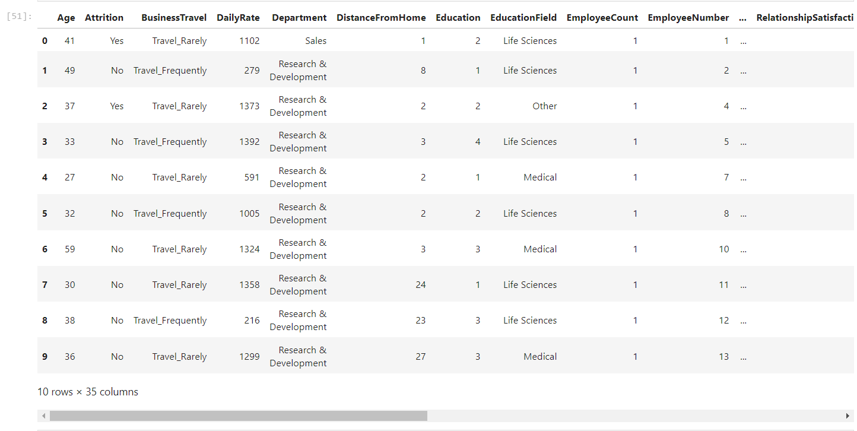
Exploratory Data Analysis (EDA)
Objective : To explore and understand the data, uncovering key patterns, relationships, and anomalies.

Slide 11
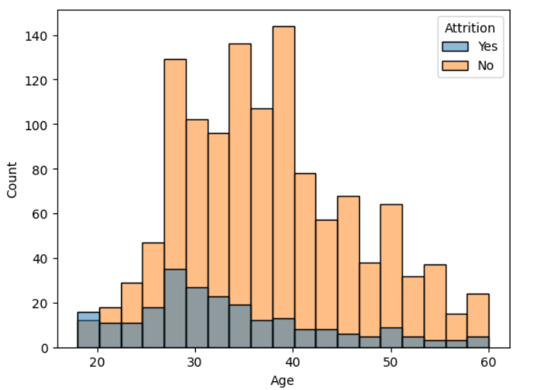
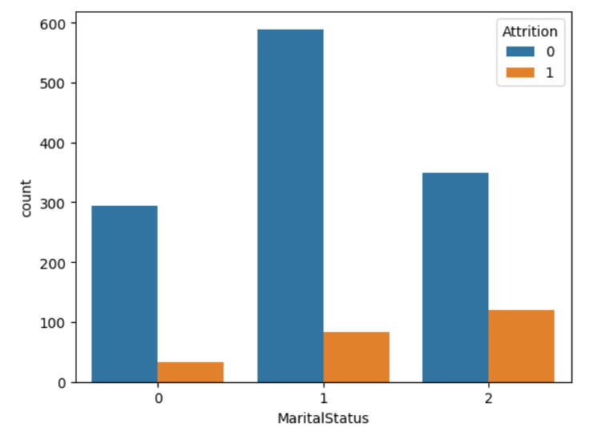
Demographic Analysis
Attrition by Age
Attrition by Marital Status
Divorced Married Single

Slide 12
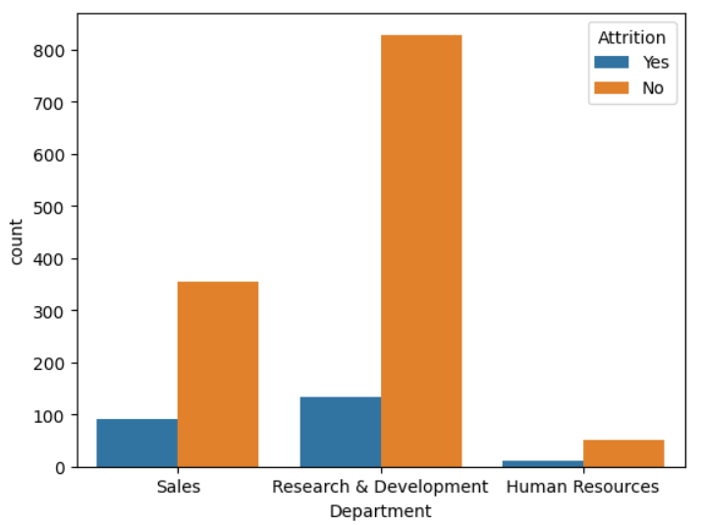
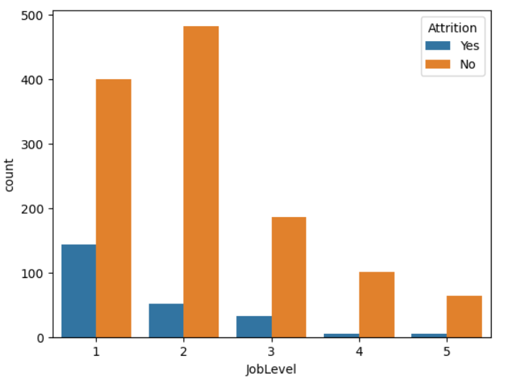
Job Related Analysis
Attrition by Department
Attrition by Job level

Slide 13
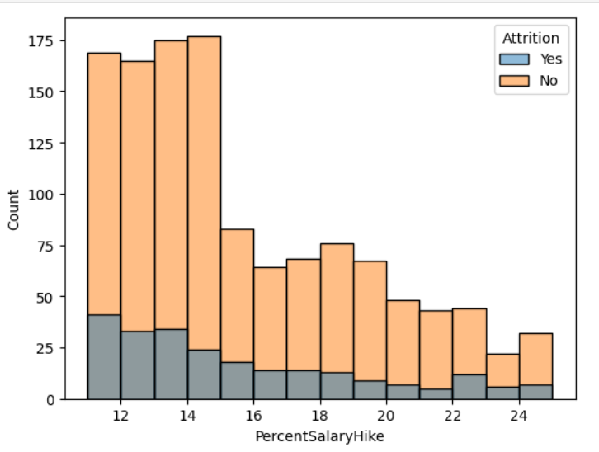
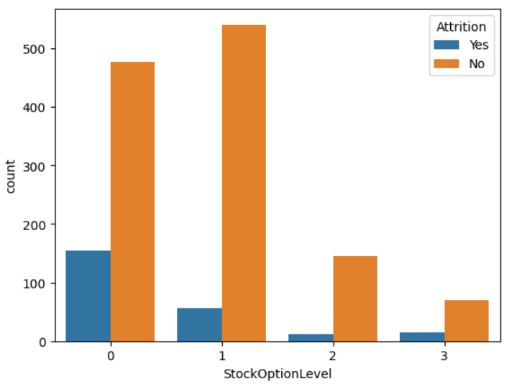
Compensation & Benefit Analysis
Attrition by Percent Salary Hike
Attrition by Stock Option Level

Slide 14
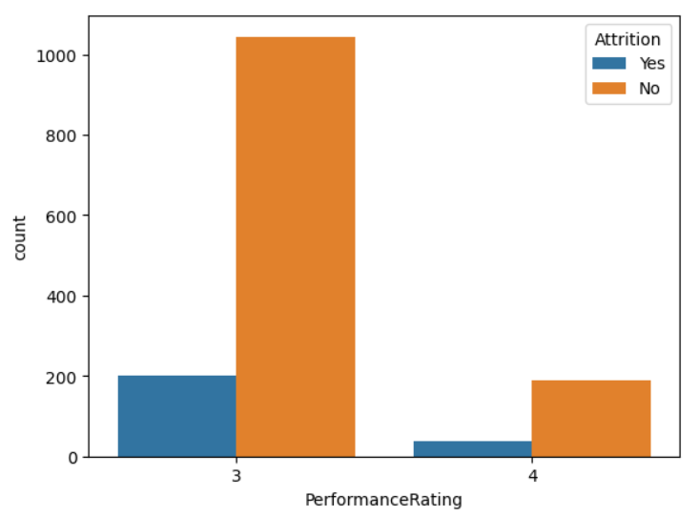
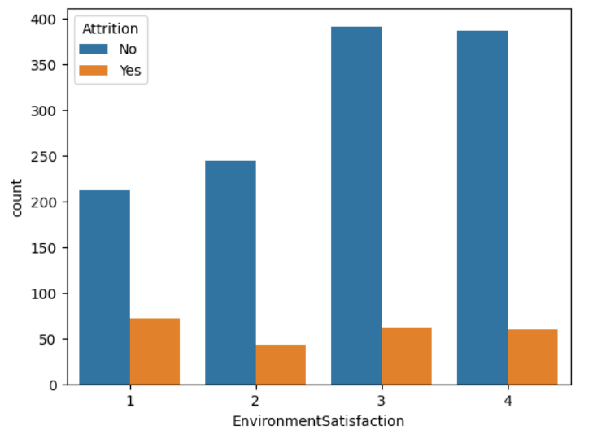
Work Environment & Performance
Attrition by Performance Rating
Attrition by Envurinment Satisfaction

Slide 15
Model Building
Purpose: To classify employees into two groups - those likely to leave (attrition) and those likely to stay .
Decision Tree Classifier
Choice of Model: A Decision Tree Classifier is chosen for its
Interpretability and ability to handle non-linear relationships .
Features Used: Key variables (e.g., job satisfaction, years at the company, salary level) used to predict attrition.

Slide 16
Model Training
Balance Data : Convert unbalance data in balance data for training .
Data Splitting: Dataset divided into training and testing sets .
Model Performance
Accuracy: Measurement of how well the model predicts employee attrition.
Implementation
Predictive Analysis: Use of the model to forecast potential attrition risk among current employees .
Risk Mitigation Strategies: Developing targeted strategies to address high-risk areas identified by the model.

Slide 17
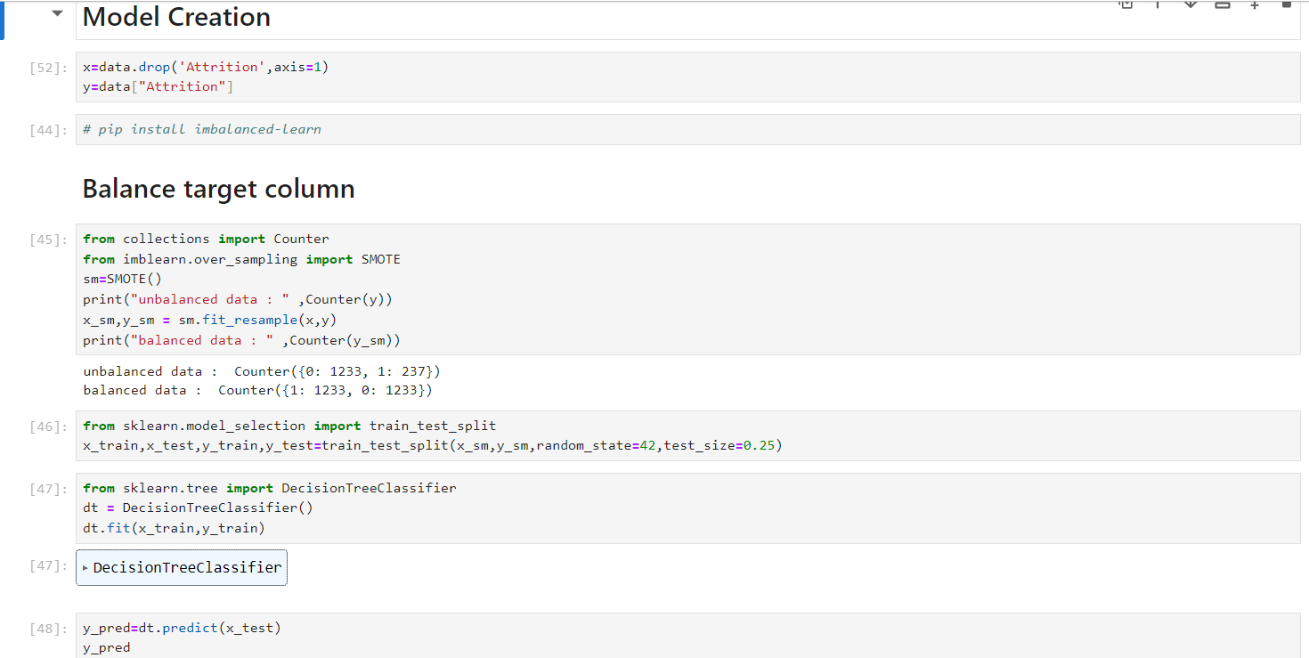
Model Building Code

Slide 18
Insights and Patterns
Major Patterns Identified Demographic Trends: Higher attrition rates in age of 18 to 25 who have single .
Compensation Factors : More Attrition rates find in Employee with low salary hike and low stock option level.
Work Environment :Employee have low work life balance and low job level and not satisfy in job environment have higher attrition count.
Predictive Factors of Attrition Top Predictors: Age , Job Satisfaction , percent hike Salary , job level , distance from home are the most influential variables in predicting attrition model

Slide 19
Policy Recommendations:
Regular Employee Feedback : Implement routine surveys and feedback mechanisms to understand employee needs and concerns .
Recognition and Reward Programs : Acknowledge and reward outstanding performance and contributions.
Professional Development Programs : Offer training, workshops, and courses for skill enhancement and career growth .
Clear Career Pathways : Provide transparent and achievable career progression opportunities .
Flexible Work Arrangements : Allow flexible hours, remote work options, or compressed workweeks .
Wellness and Mental Health Support : Prioritize employee wellness with initiatives like wellness programs or mental health days.

Slide 20
Challenges & Solutions
Data Quality and Completeness:
Inconsistent or incomplete data can lead to inaccurate predictions.
Solution: Implement robust data cleaning and preprocessing methods.
Model Complexity vs. Interpretability:
Striking a balance between a model that is both accurate and easy to interpret.
Solution: Decision Tree Classifier provides a good balance, being interpretable and reasonably accurate.

Slide 21
Changing Employee Dynamics:
Employee behavior and factors influencing attrition may change over time.
Solution: Regular model updates and retraining with new data.
Solutions to Enhance Model Efficacy
Continuous Data Monitoring :Regularly update the dataset to capture the latest trends and patterns.
Incorporating Employee Feedback : Utilize surveys or feedback tools to gather more qualitative data that can enhance the model.
Stakeholder Engagement : Work closely with HR professionals to understand domain-specific nuances and incorporate their insights into the model.

Slide 22
Conclusion
Summarizing key finding
Effective Prediction: The Decision Tree Classifier successfully identifies key factors contributing to employee attrition.
Insights into Attrition Drivers: Analysis highlights critical areas such as job satisfaction, work-life balance, and compensation as major influencers.
Data-Driven HR Strategies: The model provides actionable insights, enabling targeted strategies to reduce attrition rates.

Slide 23
Impact on the Organization
Enhanced HR Decision-Making: Empowers HR with predictive tools to proactively address attrition risks.
Improved Employee Retention: Potential to significantly reduce turnover rates, enhancing organizational stability.
Cost Savings: Lower attrition rates lead to reduced costs related to hiring and training new employees .
Future Directions
Model Refinement and Updates: Continuous improvement of the model with new data and feedback .
Broader Application Scope: Extend analysis to other aspects of HR like talent acquisition, employee engagement, etc .
Integration with HR Systems : Streamline the model's integration into existing HR workflows for real-time analysis.

